Slide 1
HOSPITAL SYSTEM NETWORK DESIGN

Slide 2
NAME OF MEMBERS:
1- Merhan Khaled Mahmoud
2- Gehad Khaled Abdel Hamied
3- Mostafa Abdou Shahat Mohamed
4- Metwaly Ebrahim Mohamed

Slide 3
Content:
1-Network Topology Using Cisco Packet Tracer
2-Hierarchical Network Design
3-Connecting Networking Devices with Correct Cabling
4-Configuring Basic Device Settings
5-VLANS assignment plus all access and trunk ports on 12 and 13 switches.
6-Switch port security to server –side site department.
7-Sub netting and IP addressing.
8-Static IP address to Server Room devices
9-DHCP Server device configurations.
10-Wireless network configurations
11-NAT Overload (Port Address Translation PAT)
12-Configuring Site-to-Site IPsec VPN.
13-Test and Verifying Network Communication.

Slide 4
Network Topology Using Cisco Packet Tracer

Slide 5
Network Topology Using Cisco Packet Tracer
Purpose: Visual representation of network layout
Components:
Core Routers at HQ and Branch, Multilayer Switches and Access Switches for departments.
Server Room with DHCP, DNS, Web, and Email Servers.
Branch connectivity via Serial link.
Guest/Waiting areas (GWA).

Slide 6
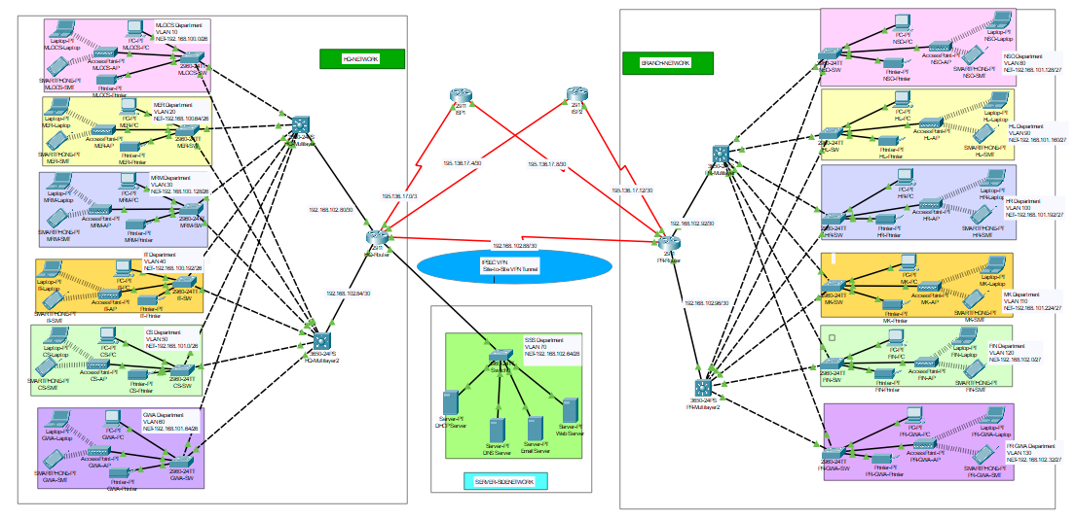

Slide 7
Hierarchical Network Design

Slide 8
Hierarchical Network Design
Three Layers:
Core Layers:
-Core Routers at HQ and Branch
-Multilayer switches for routing and switching
Distribution Layers:
-Two multilayer switches per site for redundancy
Access Layers:
-Access switches connecting end devices in each department
-Redundancy and Scalability: Ensures high availability and future growthBenefits:

Slide 9
Connecting Networking Devices with Correct Cabling

Slide 10
Connecting Networking Devices with Correct Cabling
Cabling Types:
Ethernet cables for local connections
Fiber optic cables for core connections between routers
Serial connections between HQ and Branch routers
Considerations:
Distance and speed requirements
Cost-effectiveness

Slide 11
Configuring Basic Device Settings

Slide 12
Configuring Basic Device Settings
Configurations:
Hostnames
Console and enable passwords
Banner messages
Disable IP domain lookup
SSH Configuration:
Secure remote access setup for routers and switches

Slide 13
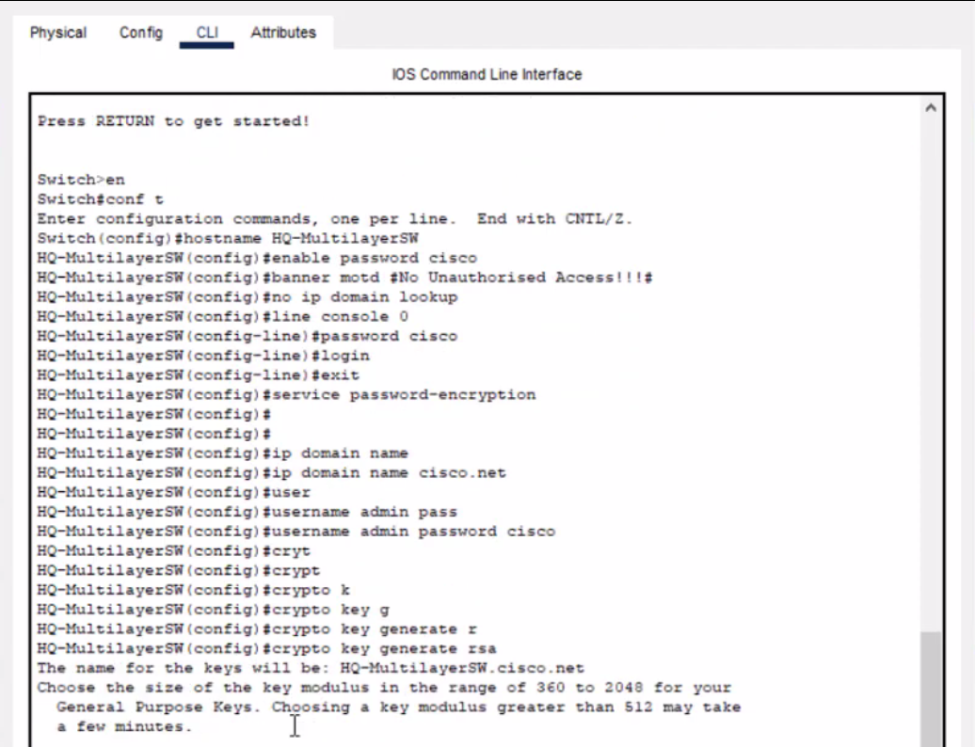
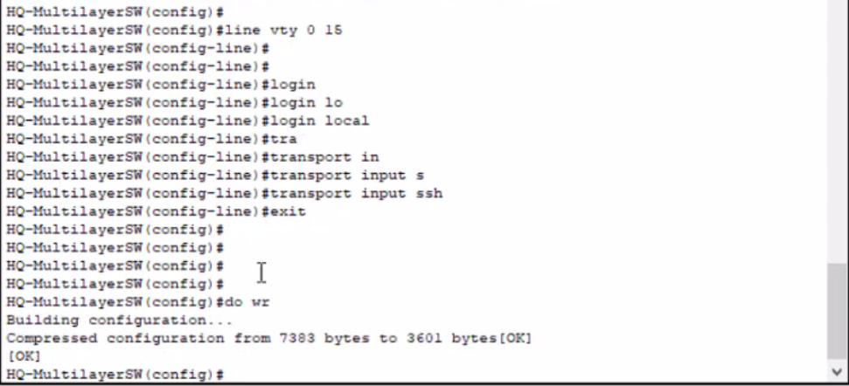

Slide 14
VLANS assignment plus all access and trunk ports on 12 and 13 switches.

Slide 16
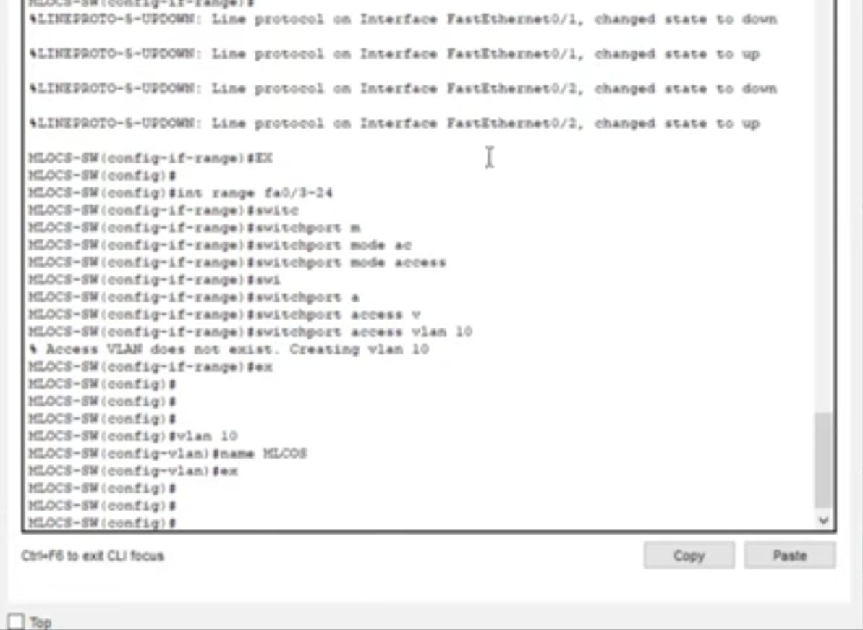
Creating VLANs and assigning ports VLAN numbers

Slide 17
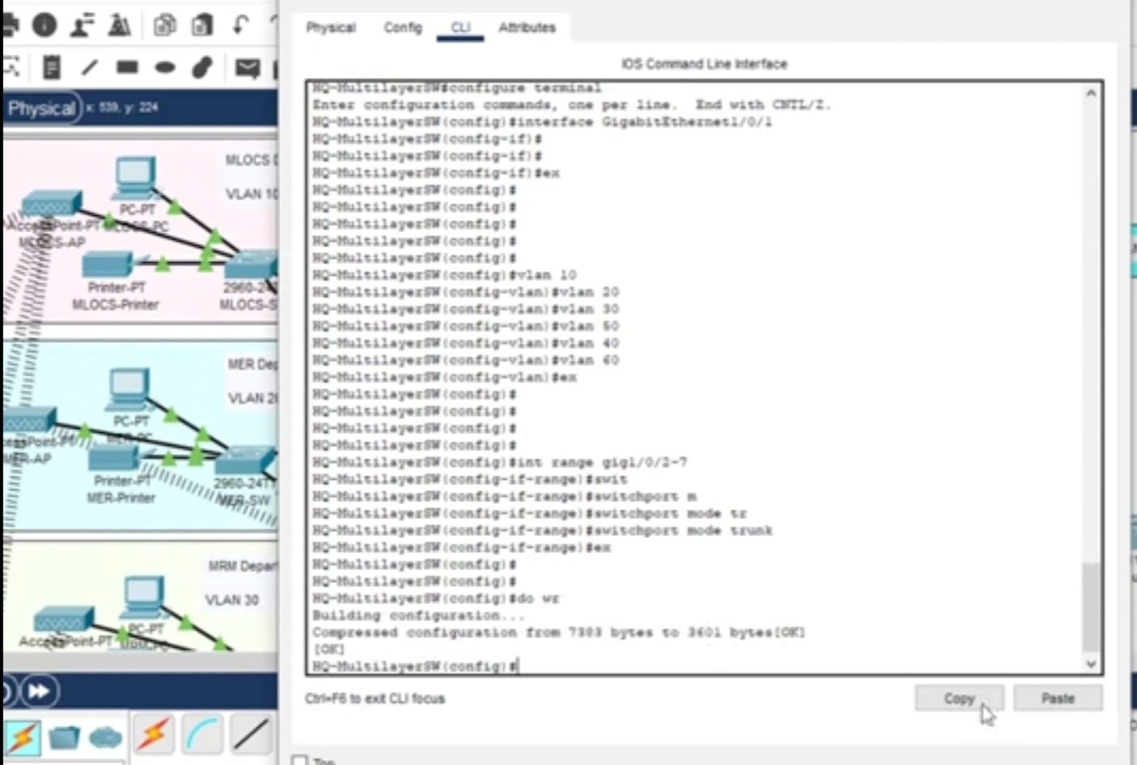

Slide 18
Switch port security to server –side site department.

Slide 19
Switch port security to server –side site department
Configure port-security for the server site department switch to allow only one device to connect to a switch port, use sticky method to obtain mac-address and violation mode shutdown.

Slide 20
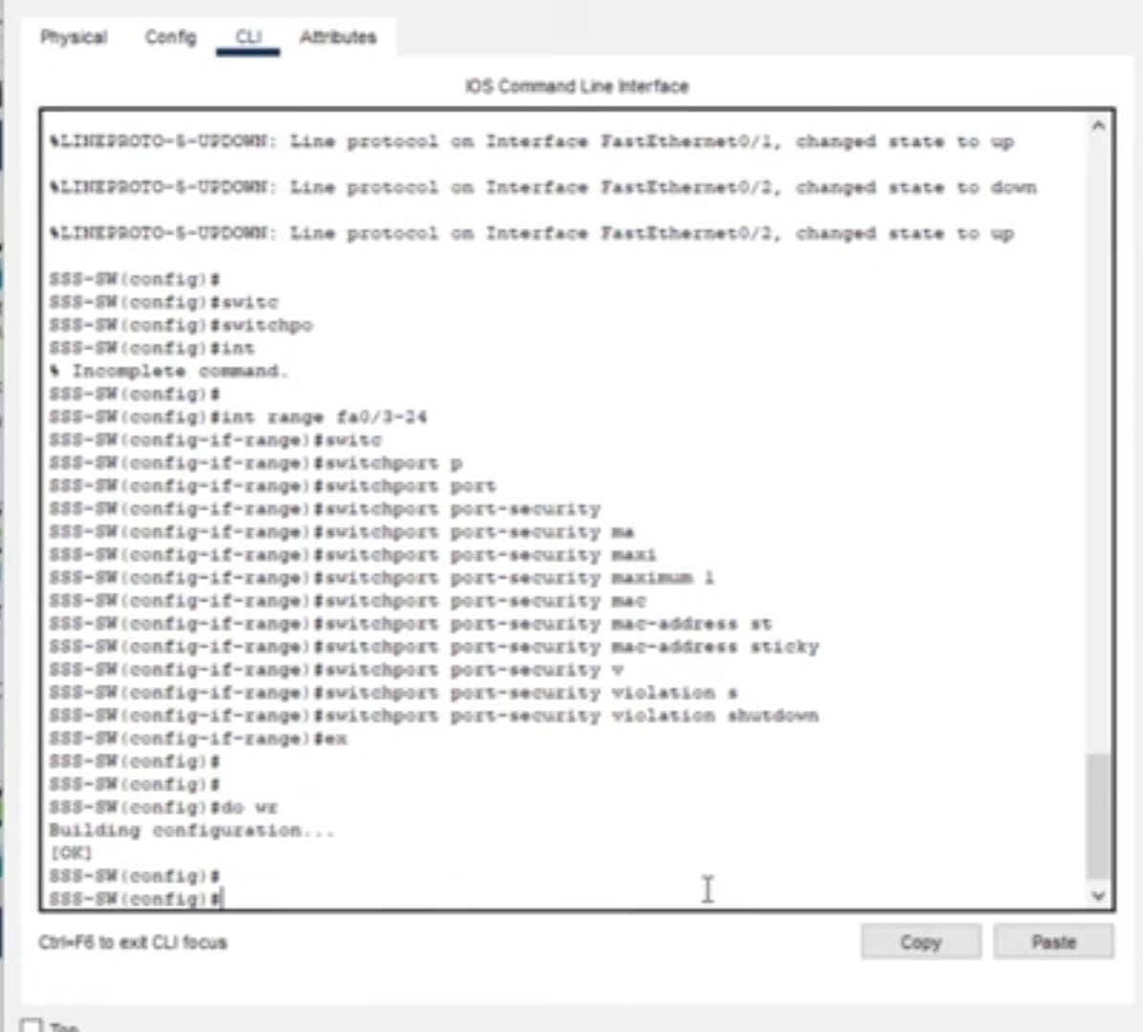
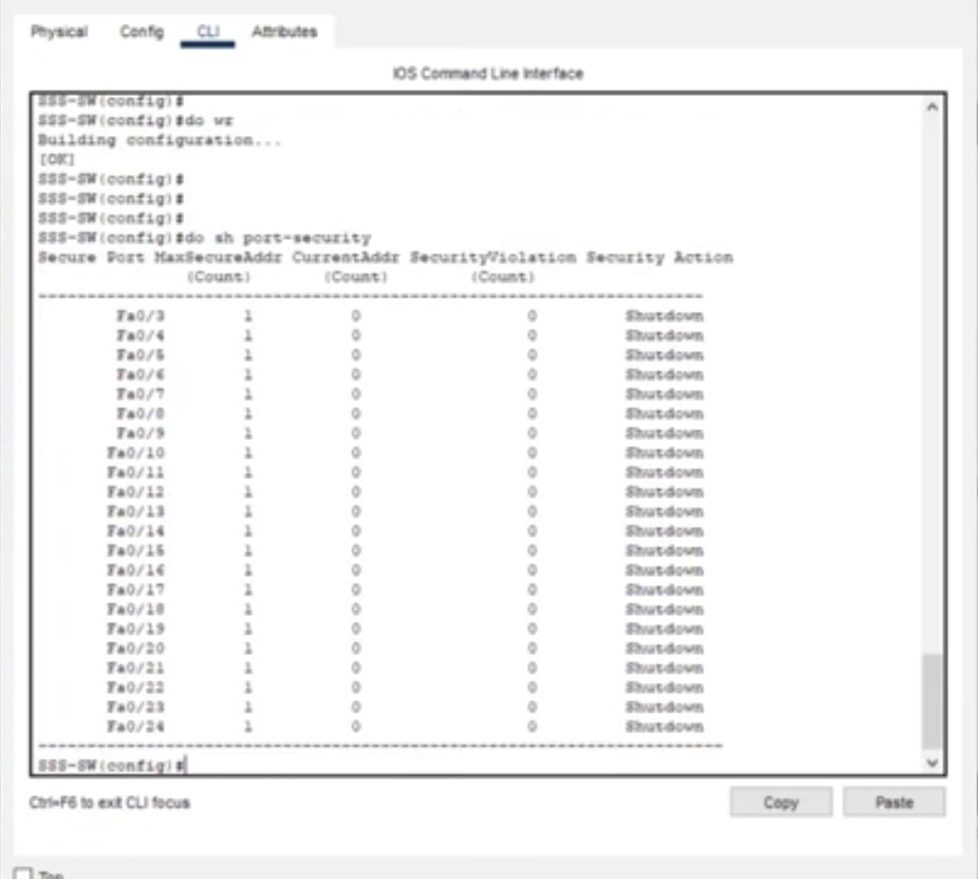

Slide 21
Sub netting and IP addressing.

Slide 22
Sub netting and IP addressing.
Provided a base network of 192.168.100.0, and carry out sub netting to allocate the correct number of IP addresses to each department.
The company network is connected to the static, public IP addresses (Internet Protocol) 195.136.17.0/30, 195.136.17.4/30, 195.136.17.8/30, and 195.136.17.12/30 connected to the two Internet providers.

Slide 23
IP Addressing
Base Network: 192.168.100.0
HQ Hospital
Department | Network Address | Subnet Mask | Host Address Range | Broadcast Address
MLOCS | 192.168.100.0 | 255.255.255.192/25 | 192.168.100.1 to 192.168.100.62 | 192.168.100.63
MER | 192.168.100.64 | 255.255.255.192/25 | 192.168.100.64 to 192.168.100.126 | 192.168.100.127
MRM | 192.168.100.128 | 255.255.255.192/25 | 192.168.100.129 to 192.168.100.190 | 192.168.100.191
IT | 192.168.100.192 | 255.255.255.192/25 | 192.168.100.193 to 192.168.100.254 | 192.168.100.255
CS | 192.168.101.0 | 255.255.255.192/25 | 192.168.100.1 to 192.168.100.62 | 192.168.100.63
GWA | 192.168.101.64 | 255.255.255.192/25 | 192.168.100.64 to 192.168.100.126 | 192.168.100.127

Slide 24
Branch Hospital
Department | Network Address | Subnet Mask | Host Address Range | Broadcast Address
NSO | 192.168.101.128 | 255.255.255.224/27 | 192.168.101.129 to 192.168.101.158 | 192.168.101.159
HL | 192.168.101.160 | 255.255.255.224/27 | 192.168.101.161 to 192.168.101.190 | 192.168.101.191
HR | 192.168.101.192 | 255.255.255.224/27 | 192.168.100.129 to 192.168.100.190 | 192.168.101.223
MK | 192.168.101.224 | 255.255.255.224/27 | 192.168.101.193 to 192.168.101.222 | 192.168.101.255
FIN | 192.168.102.0 | 255.255.255.224/27 | 192.168.102.1 to 192.168.102.30 | 192.168.102.31
BR-GWA | 192.168.102.32 | 255.255.255.224/27 | 192.168.102.33 to 192.168.102.62 | 192.168.102.63

Slide 25
Server-Side Site
Department | Network Address | Subnet Mask | Host Address Range | Broadcast Address
SSS | 192.168.102.64 | 255.255.255.240/28 | 192.168.102.95 to 192.168.102.78 | 192.168.102.79
Between the Routers and Layer-3 Switchs
NO. | Network Address
HQR1-HQMLSW1 | 192.168.102.80/30
HQR1-HQMLSW2 | 192.168.102.84/30
BRR1-BRMLSW1 | 192.168.102.88/30
BRR1-BRMLSW2 | 192.168.102.92/30
HQR1-BRR1 | 192.168.102.96/30
Between the Routers and ISPs
Public IP Address 195.136.17.0/30,195.136.17.4/30,195.136.17.8/30 and195.136.17.12/30

Slide 26
OSPF on the routers and 13 switches

Slide 27
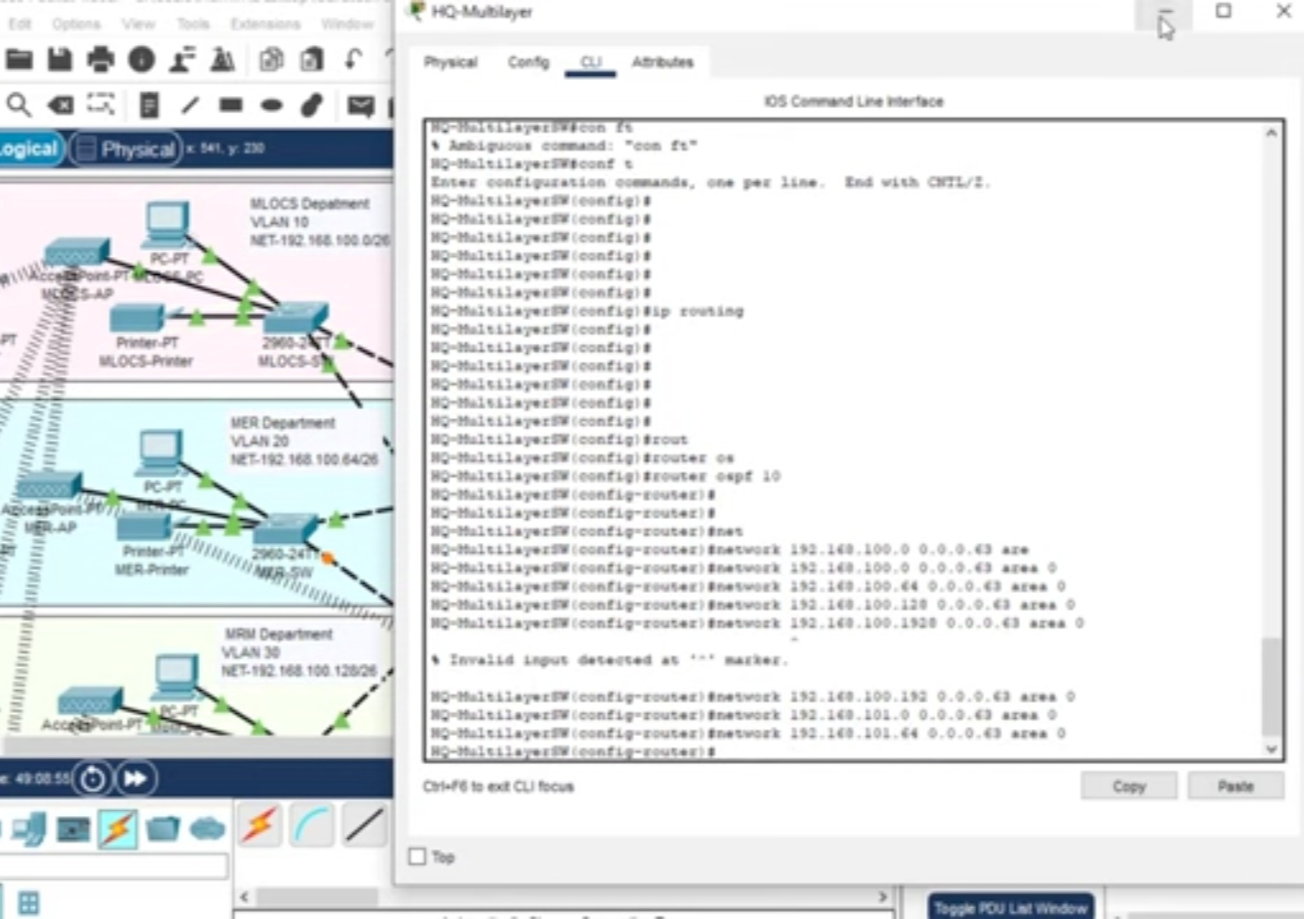

Slide 28
Default static route

Slide 29
Configure default static routing to enable routers and multilayer switches to forward any traffic that does not match routing table entries. Use next-hop IP addresses.

Slide 30
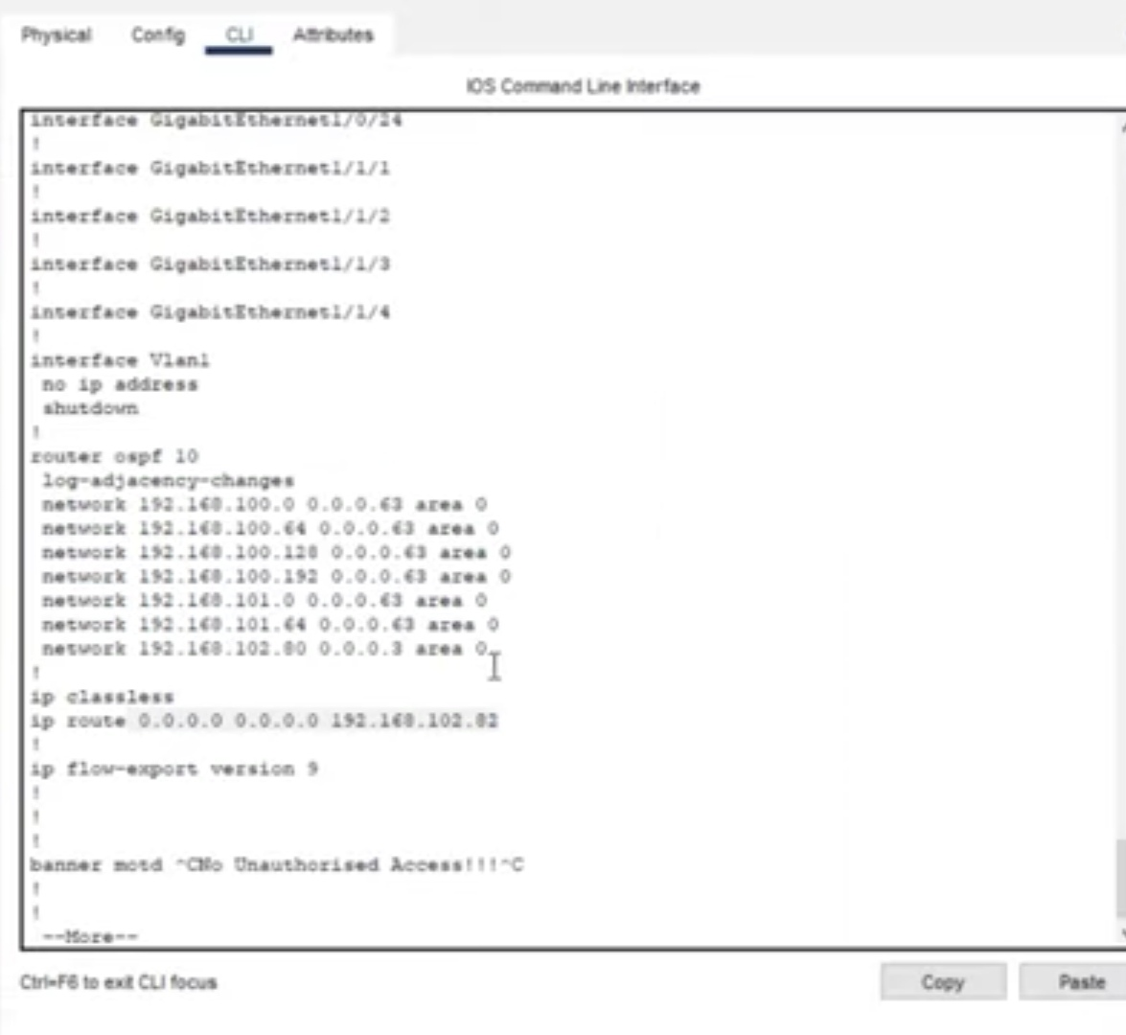

Slide 31
Static IP address to Server Room devices

Slide 32
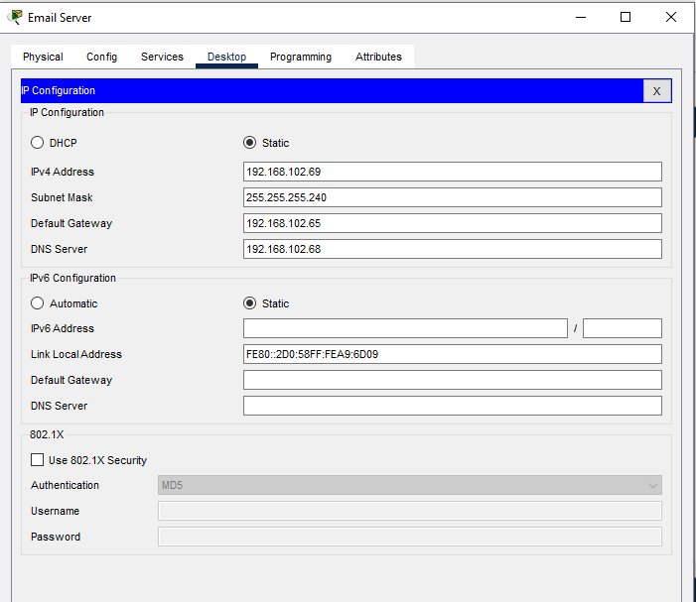
Static IP address to Server Room devices
Configure Devices in the server room IP addresses statically
Server Name | IP Addresses
DHCP Server | 192.168.102.67
DNS Server | 192.168.102.68
Email Server | 192.168.102.69
Web Server | 192.168.102.70

Slide 33
DHCP Server device configurations.

Slide 34
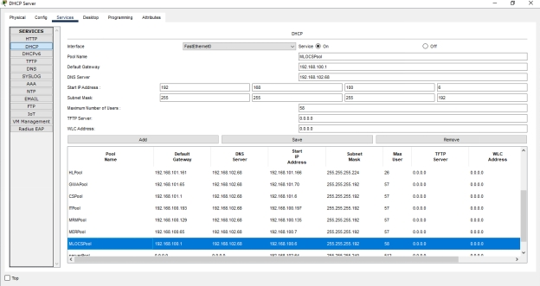
DHCP Server device configurations.
* All devices in the network are expected to obtain an IP address dynamically from the dedicated DHCP servers located in the server room.

Slide 35
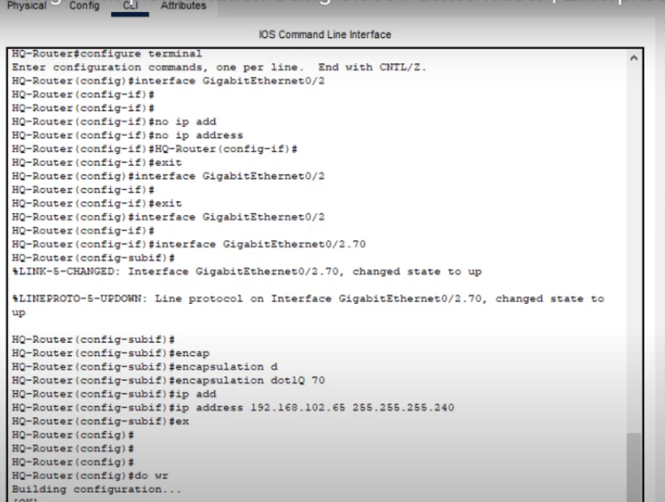
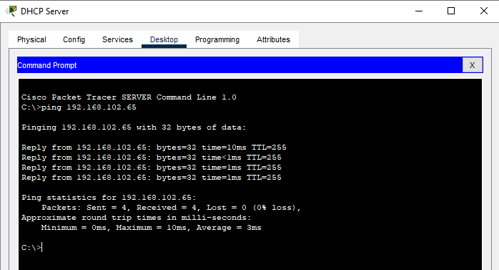

Slide 36
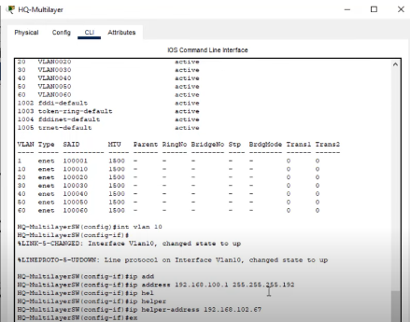
Inter-VLAN routing on the 13 switches plus IP DHCP helper addresses.

Slide 37
Wireless network configurations

Slide 38
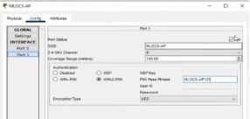
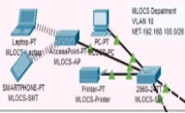
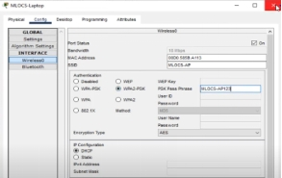
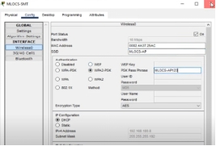
Configuring wireless network (Cisco Access Point)

Slide 39
NAT Overload (Port Address Translation PAT)

Slide 40
NAT Overload (Port Address Translation PAT)
Adjusting the clock rate of the DCE serial cables which connect between the routers.
Configure PAT to use the respective outbound router interface IPv4 address of the HQ and Branch Routers.
#ip nat outside # ip nat inside
# ip nat inside source list 1 interface Serial0/2/1 overload
implement the necessary ACL rule.
#access-list 1 permit 192.168.100.0 0.0.0.63
#access-list 1 permit 192.168.100.64 0.0.0.63
#access-list 1 permit 192.168.100.128 0.0.0.63
#access-list 1 permit 192.168.100.192 0.0.0.63
#access-list 1 permit 192.168.101.0 0.0.0.63
#access-list 1 permit 192.168.101.64 0.0.0.63

Slide 41
Configuring Site-to-Site IPsec VPN.

Slide 42
Configuring Site-to-Site IPsec VPN.
1- configure ISP routers
2-Enabling the security license on the routers
# license boot module c2900 technology –package securityk9
3-Configure the extended ACL rule together with site-to-site VPN(IP Sec VPN) to
a tunnel and encrypt communication between HQ and the Branch network
#access –list 110permit ip 192.168.100.0 0.0.0.255 192.168.101.0 0.0.0.255
#access –list 110permit ip 192.168.101.0 0.0.0.127 192.168.101.0 0.0.0.255
4-configure a basic setup for ISAKMP policy:
#crypto isakmp policy 10
#authentication pre-share
# group 5

Slide 43
5- set the pre-shared key ‘cisco’ for the VLAN peer
# crypto isakmp key cisco address 192.168.102.90
6- set up your IPSec transform set to use AES for encryption and SHA-HMAC for integrity
# crypto ipsec transform-set VPN – set esp-aes esp-sha-hmac
7-brind the transform set and the ACL to the crypto map:
# crypto map VPN-MAP 10 ipsec-isakmp
#description this VPN connects to Branch-Network
#set peer 192.168.102.90
#set transform-set VPN-Set
#match address 110
8-apply this crypto map to the interface:
#crypto map VPN-Map

Slide 44
Test and Verifying Network Communication.

Slide 45
Test and Verifying Network Communication.
1-To display the current NAT translations, you’d use the command: # show ip nat translations
The result:
Pro Inside global Inside local Outside local Outside global
icmp 195.136.17.9:1 192.168.101.169:1 195.136.17.2:1 195.136.17.2:1
icmp 195.136.17.9:3 192.168.101.169:3 195.136.17.2:3 195.136.17.2:3
2-To display the current status of the IPsec Security Associations (SAs), you'd use: # show crypto
ipsec sa The result:
#pkts encaps: 3, #pkts encrypt: 3, #pkts digest: 0
#pkts decaps: 1, #pkts decrypt: 1, #pkts verify: 0
#pkts compressed: 0, #pkts decompressed: 0
#pkts not compressed: 0, #pkts compr. failed: 0
#pkts not decompressed: 0, #pkts decompress failed: 0
#send errors 1, #recv errors 0

Slide 46
THANK YOU

